Slide 1


Slide 2

Our Code of Conduct
Be welcoming and respectful
Be open to all questions and viewpoints
Be understanding of differences
Be kind and considerate to others
Be aware of others
Be friendly and patient
Microsoft is dedicated to empowering every person and every organization on the planet to achieve more. This includes Microsoft Reactor events where we seek to provide a respectful, friendly, professional experience for everyone, regardless of gender, sexual orientation, physical appearance, disability, age, race or religion. We do not tolerate any behaviour that is harassing or degrading to any individual, in any form. Individuals are responsible for knowing and abiding by these standards. We encourage everyone to assist in creating a welcoming and safe environment.
Notes:
Before we get into it a quick word on our code of conduct.
The key thing to take out here is to be respectful of other people’s views, understanding of differences and kind and considerate in the way you engage.
The chat will be open throughout and we do encourage you all to participate.
And with that, I will hand over to Ben.

Slide 3



Speaker Bio
Hadeel Shubair
Regional Cloud Advocate - Microsoft
Hadeel Shubair
@Hshubair3

Slide 4
Learning Objectives
Data Science Lifecycle – Overview
Exploratory Data Analysis
Data Visualization
Example - walkthrough

Slide 5
Let’s define data science!

Slide 6

Data Science
Definition:
- Data science is the domain of study that deals with vast volumes of data using modern tools and techniques to find unseen patterns, derive meaningful information, and make business decisions. Data science uses complex machine learning algorithms to build predictive models.
Goal:
- To construct the means for extracting business-focused insights from data.
- This requires an understanding of how value and information flows in a business, and the ability to use that understanding to identify business opportunities.

Slide 7

Data science is an iterative process between:
The knowledge and understanding of what is today
Data that has been collected
Questions that are being asked

Slide 8
Data Science lifecycle

Slide 9
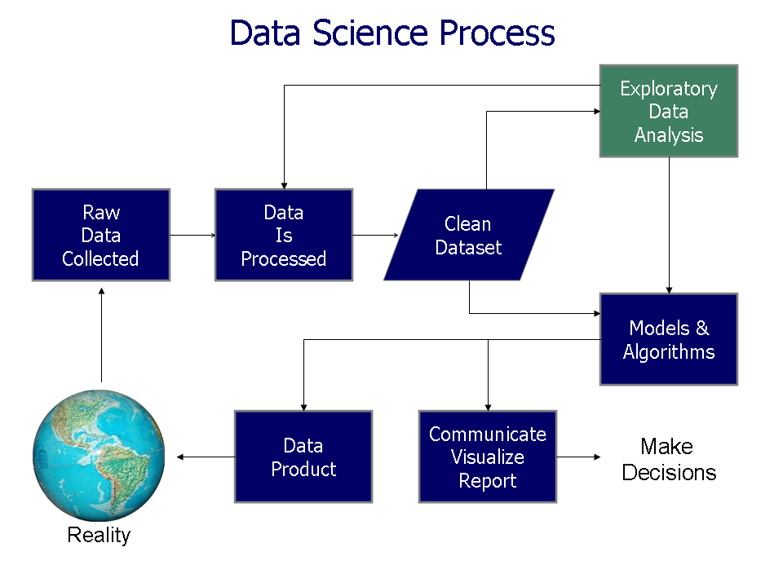

Slide 10
Last time, we explored the first stage in the DS lifecycle - Data cleaning & preprocessing

Slide 11
Steps - Data cleaning
Data should be preprocessed and cleaned to get rid of noisy data.
We collected our data, inspected it, then had to clean it. The steps taken to clean our data include:
Dealing with missing data
Removing unused columns
Converting categorical into categorical numerical data
Normalization: standardize data ranges for all features (between 0 & 1) – Min-max normalization

Slide 12
Today, we will focus on Data Exploration & Visualization

Slide 13
Let’s begin!

Slide 14
Intro
Have you ever seen a raw data set? Maybe it was in a comma delineated file, there's not much you can do with that & not much sense you can make of it
With something known as Exploratory data analysis, you can open up your eyes to a world of many possibilities, connections, and interesting tidbits you'd never otherwise spot!

Slide 15

What is Exploratory Data Analysis?

Slide 16
Exploratory Data Analysis (EDA)
Exploratory data analysis is an approach of analyzing data sets to summarize their main characteristics, often using statistical graphics and other data visualization methods
It is used to discover trends, patterns, or to check assumptions with the help of statistical summary and graphical representations.
An exploratory analysis is a good starting point for defining future studies and getting to know your data to get deeper insights.
EDA is one big detour – there’s no real structured way to do it. It’s an iterative process.

Slide 17

What is EDA used for?
Exploratory data analysis can help:
Detect obvious errors
Identify outliers in datasets
Understand relationships
Identify important factors in the data
Find patterns within data
Test assumptions
Provide new insights
Why do we need EDA?
EDA helps uncover the underlying structure of a dataset and is important for a company because it exposes trends, patterns, and relationships that are not readily apparent

Slide 18
The EDA steps that analysts have in mind when performing EDA include:
Asking the right questions related to the purpose of data analysis
Obtaining in-depth knowledge about problem domains
Setting clear objectives that are aligned with the desired outcomes.

Slide 19
Why is exploratory data analysis important in data science?

Slide 20
Why is EDA important in data science?
EDA is essential for any business. It allows data scientists to analyze the data before coming to any assumption
EDA ensures that the results produced are valid and applicable to business outcomes & goals.
EDA helps stakeholders by confirming they are asking the right questions.
EDA helps answer questions about standard deviations, categorical variables, & confidence intervals.
Once EDA is complete and insights are drawn, its features can then be used for more sophisticated data analysis or modeling, including machine learning.

Slide 21
In conclusion..
Exploratory data analysis comes in handy whenever a data scientist needs to gain new insights into a massive quantity of data sets.
In this aspect, EDA can be beneficial for many fields such as R&D, engineering, and data science.
EDA can be an engaging experience for researchers/data scientists to explore unexpected values in a massive quantity of complex datasets.
The goal is to explore, investigate and learn, as opposed to confirming statistical hypotheses.

Slide 22

Next: Data Visualization

Slide 23
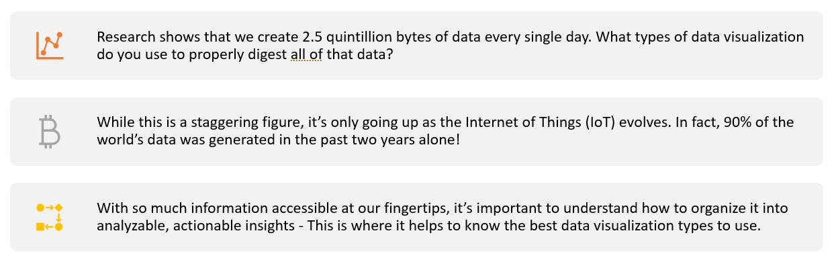

Slide 24

Why do we visualize data?
Data scientists visualize data to understand it better. This can mean looking at the raw data, summary measures such as averages, or graphing the data.
Data visualization gives us a clear idea of what the information means by giving it visual context through maps or graphs. This makes the data more natural for the human mind to comprehend and therefore makes it easier to identify trends, patterns, and outliers within large data sets.
3 elements of a successful data visualization:
It understands the audience
It sets up a clear framework
It tells a story!

Slide 25

What is Data Visualization?

Slide 26
What is Data Visualization?
Data Visualization is the process of analyzing data in the form of graphs or maps, making it a lot easier to understand the trends or patterns in the data.
Raw data → visual objects & figures
Goal?
To communicate data or information clearly & effectively to readers
Provides a quick, high-level summary of the main information contained in the data
Enables decision-makers to see analytics presented visually, so they can grasp difficult concepts or identify new patterns

Slide 27

What is Data Visualization used for?
Data, especially a lot of data, can be difficult to wrap your head around. Data visualization can help both you and your audience interpret and understand data.
Data visualizations often use elements of visual storytelling to communicate a message supported by the data.
Data visualization can be used for:
Making data engaging & easily digestible
Identifying trends and outliers within a set of data
Telling a story found within the data
Highlighting the important parts of a set of data
Answering questions & supporting decisions

Slide 28
Why use Data Visualization?
Here are a few reasons to represent data visually:
Use charts and graphs to display data visually: Numbers on their own can be hard to understand. Data visualization makes all your data easier to decipher. This is achieved through graphical representations.
Find trends by comparing a data point to another: Raw data doesn't show you connections or trends. By visualizing data through charts and graphs, you can show how sets of data are related and what steps to take next.
Tell business stories through interactive visualization: It's hard to tell good stories when you're dealing with big data. A good visualization tool like network graphs can better show the significance of the data collected.
Allows business users to gain insight into their vast amounts of data: With the use of visualizations, business users will be able to understand their data more, and make valuable insights based on it.

Slide 29
There are many types of data visualizations – ranging from charts, graphs, maps, etc.
Part of the strategy of visualizing data is choosing what type of data visualization to use - the trick is to select the one that will best represent your data’s message and story
Before you choose what chart type to use, you need to get to know your data better, the story behind it, and your target audience/media

Slide 30
Types of Visualizations

Slide 31
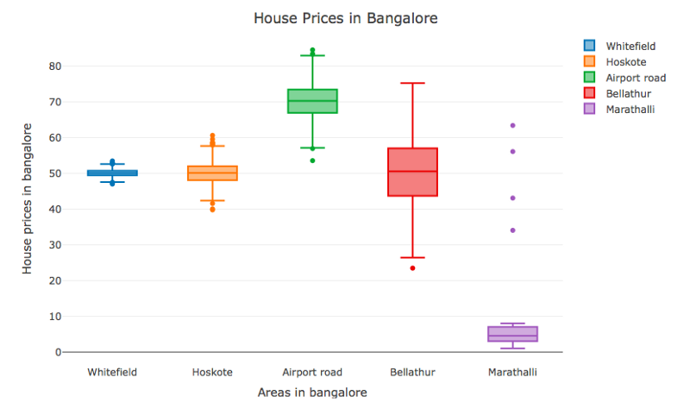
Boxplots
Useful for visualizing a dataset’s key statistics
Used to show distributions of numeric data values, especially when you want to compare them between multiple groups
We can use them to represent minimum & maximum values, the median value, and the lower and upper quartiles (i.e. the median of the lower and upper halves of the data)
Used for detecting outliers

Slide 32
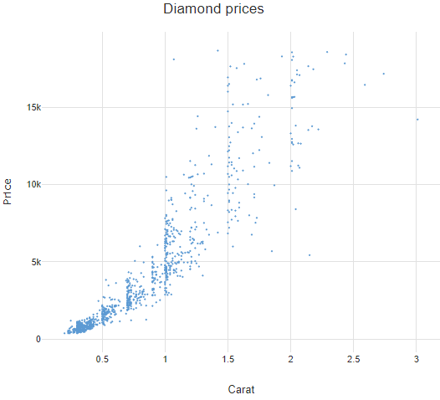
Scatter plots
Primary use: to display the relationship between two variables on an x & y-axis
Each item of data is shown as a single point, creating the chart’s visual ‘scatter’ effect
Best used for large datasets where time is not a significant factor
Best for inferring relationships between variables rather than drawing firm conclusions

Slide 33
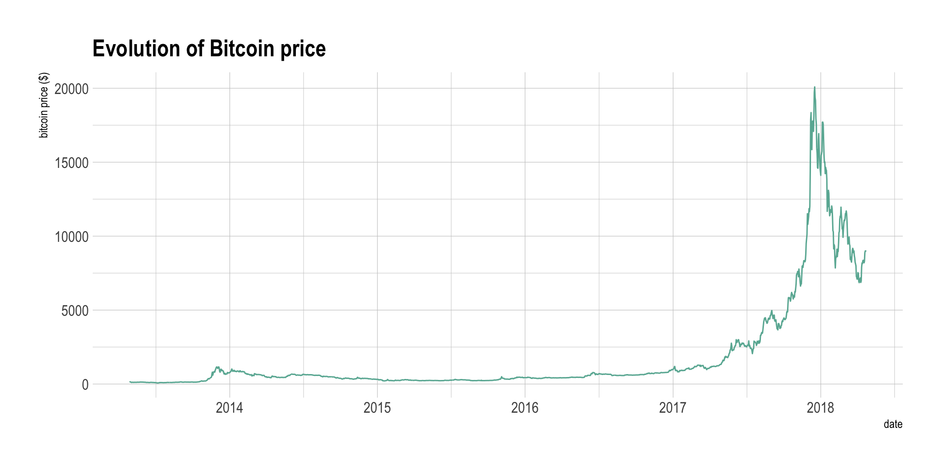
Line graphs
Used to track changes over short & long periods of time (time-series data)
Visually similar to scatterplots but represent data points separated by time intervals with segments joined by a line
Allows for quick observation of features like acceleration, deceleration, and volatility
Effective for: Comparing lots of data all at once, showing changes & trends over time, displaying forecast data, highlighting anomalies across data series

Slide 34
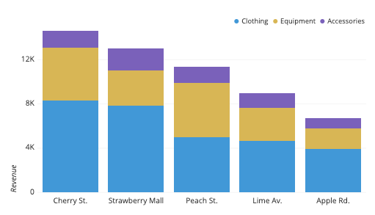
Bar charts
Used to compare a single category of data or several
Used when you want to show a distribution of data points or perform a comparison of metric values across different subgroups of your data
The heights (or widths) of the bars are in direct proportion to the values they represent- this makes bar charts an excellent way of comparing discrete variables at a glance
Some bar charts cluster bars into groups of two or three (or more) allowing you to compare numerous variables at different points in time

Slide 35
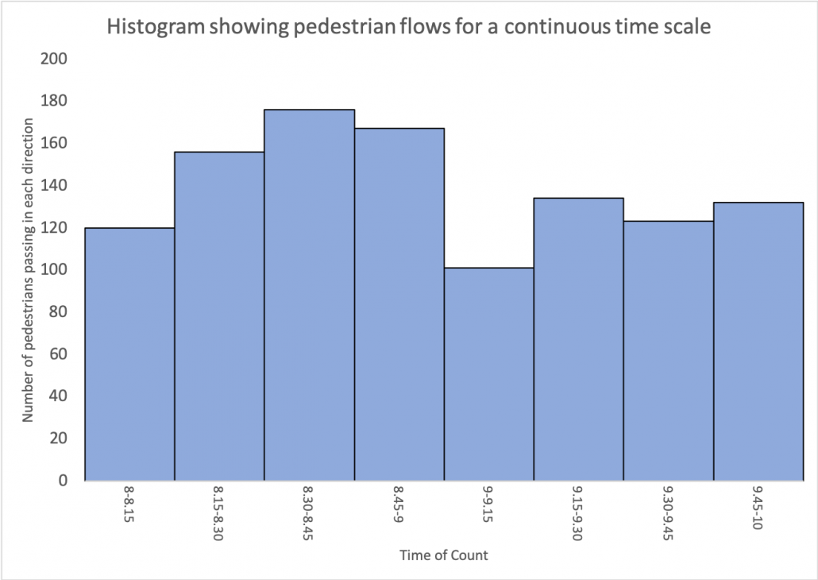
Histograms
Although visually similar to bar charts, histograms are not the same thing - Bar charts measure categorical data, while histograms measure the distribution of numerical data, i.e. the frequency with which a discrete data point appears in a dataset
Use histograms when you have continuous measurements and want to understand the distribution of values and look for outliers
In a histogram, each bar represents how often a data point falls within a given range
For example, each column might represent different age groups (20 to 29, 30 to 39, etc). This makes histograms excellent for summarizing large amounts of continuous data without needing to inspect every single value

Slide 36
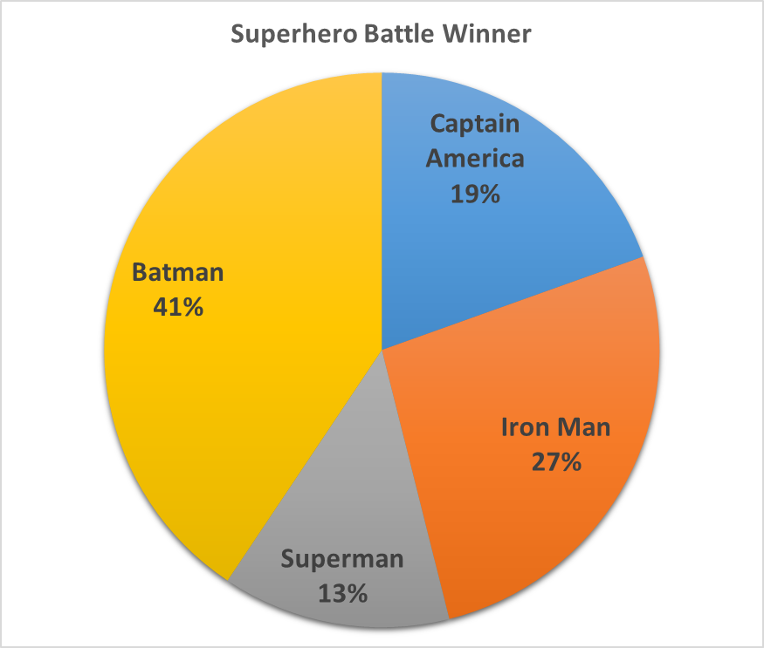
Pie charts
Used to represent a single variable, broken down into percentages or proportions
Best-suited to data that is split into categories

Slide 37
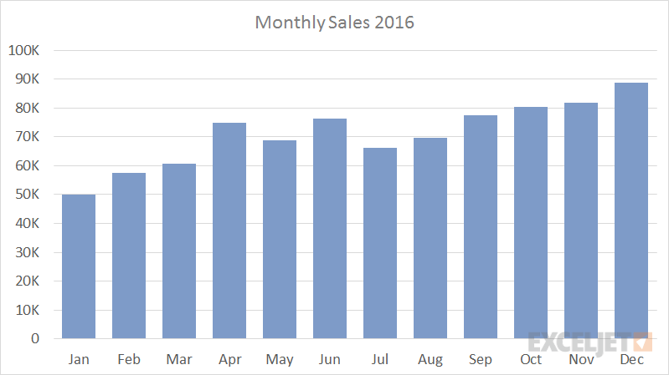
Column charts
Useful for showing data changes over a period of time/for illustrating comparisons among items
Categories are typically organized along the horizontal axis & values along the vertical axis
We can use column charts to track monthly sales figures or revenue per landing page

Slide 38
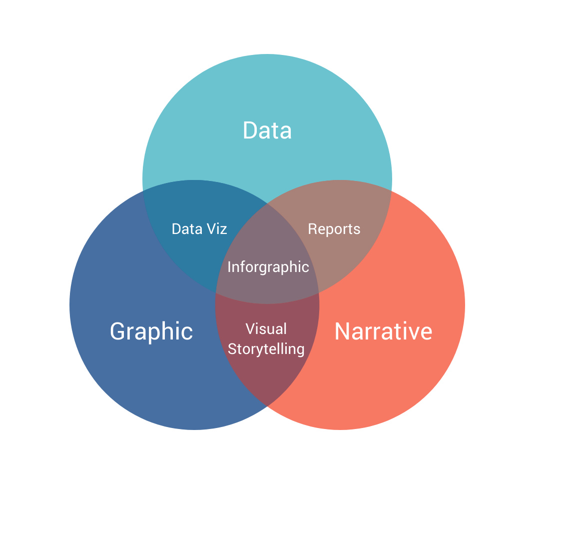
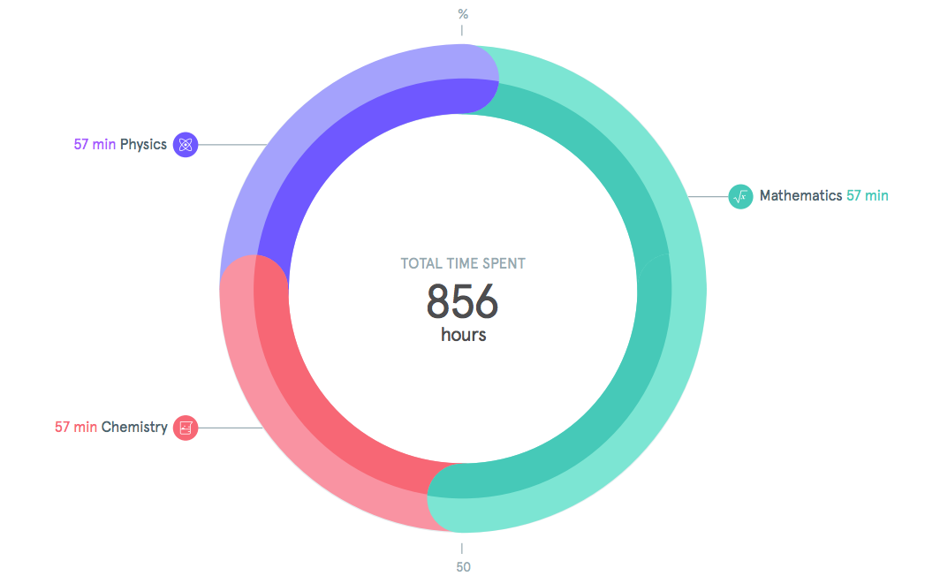
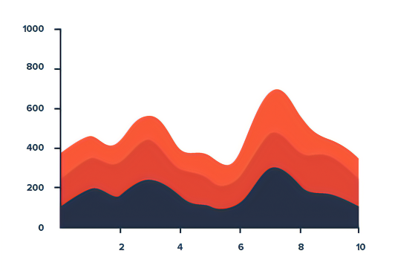
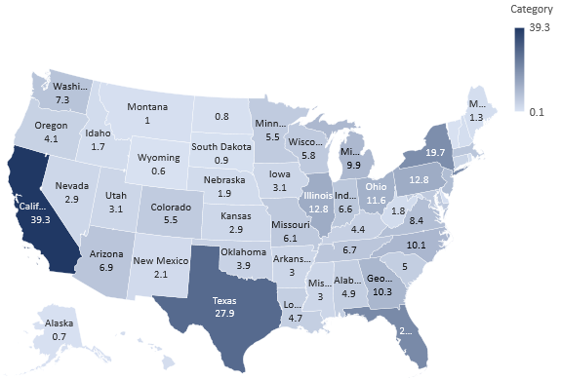
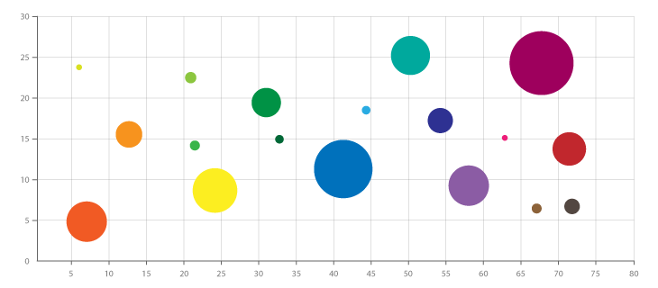
Other charts
Venn diagram
Area chart
Donut chart
Map chart
Bubble chart

Slide 39
Guide: How to choose the best charts for your data Infographic charts come in many forms, so how should you decide which one to use? The following guide will help you pick the best charts for your data based on your goals – either to inform, compare, show change, organize, or reveal relationships.

Slide 40
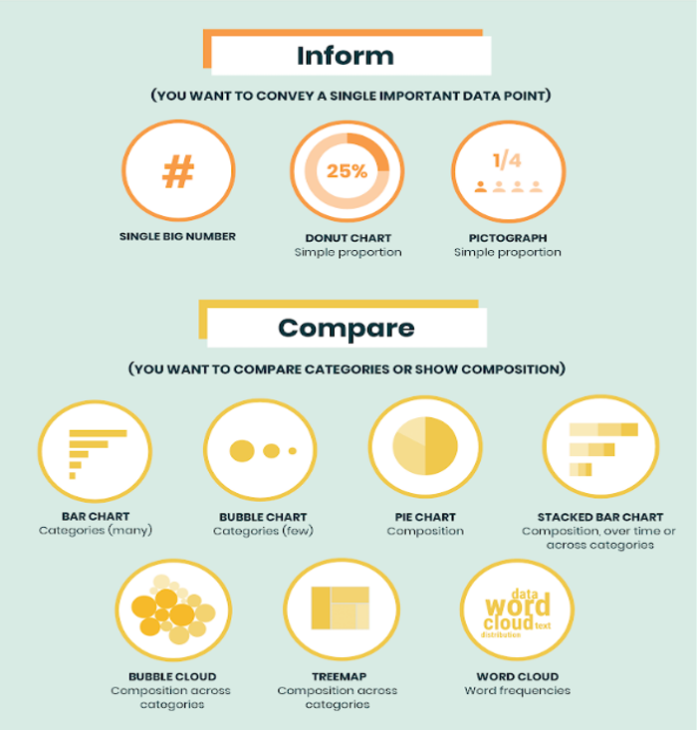
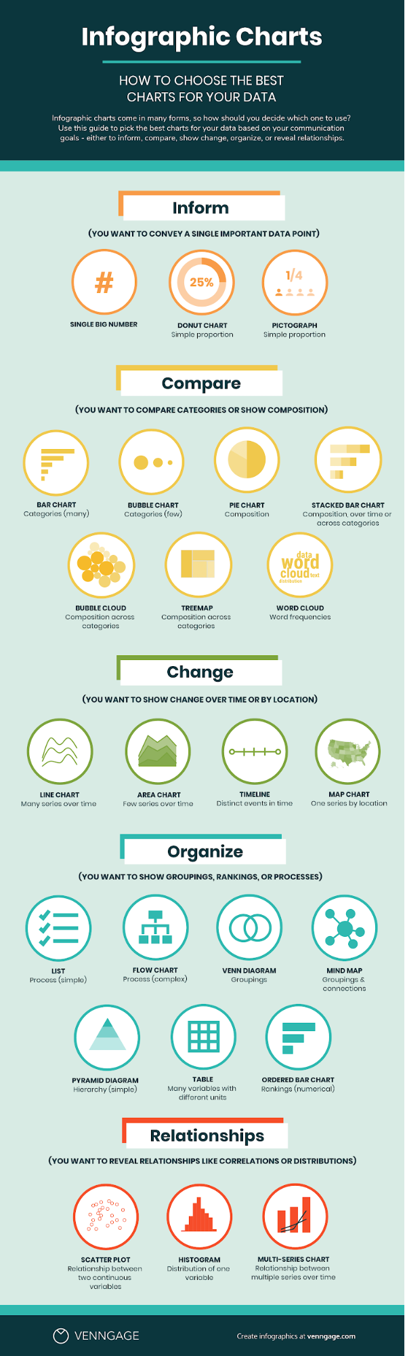
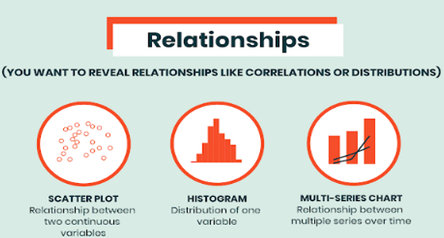

Slide 41
Tips - Chart selection
Whenever you decide to create some data visualization, use these best practices to make it more straightforward and effective.
If you have categorical data, use a bar chart if you have more than 5 categories or a pie chart otherwise.
If you have nominal data, use bar charts or histograms if your data is discrete, or line/area charts if it is continuous.
If you want to show the relationship between values in your dataset, use a scatter plot, bubble chart, or line charts.
If you want to compare values, use a pie chart — for relative comparison — or bar charts — for precise comparison.
If you want to compare volumes, use an area chart or a bubble chart.
If you want to show trends and patterns in your data, use a line chart, bar chart, or scatter plot.

Slide 42
The importance of Data Storytelling

Slide 43

Data Storytelling
Data storytelling: using data to effectively communicate insights.
Most people who look at data won’t understand its significance - Data storytelling helps bring data to life and make it meaningful and accessible for far more people
Data storytelling goes one step further and helps businesses understand the broader context of data, as well as an explanation of the ‘why’ behind the data
Data storytelling is beneficial because it:
Provides new perspectives
Ensures that key findings are as accessible as possible, to as many people as possible
Assists others with interpreting otherwise complex information

Slide 44
Example: Medical Insurance cost prediction

Slide 45
Further learning/resources
https://aka.ms/DataExplorationAndAnalysis
https://aka.ms/DataVisualizationFundamentals

Slide 46
Recap

Slide 47


Slide 48


Thank You!
meetup.com/pro/microsoft-reactor/
@MSFTReactor
https://aka.ms/ReactorYouTube
aka.ms/ReactorEmailSignUp
https://www.meetup.com/pro/microsoft-reactor/

